Slide 1
BIT System Legion
Second Pilot

Slide 2
Meet the Team
BACK-END developers
PROJECT MANAGER
AK KIDI
AK Kidi
CM Sabiti
BI Leso
designers
A Thinta
K Selebano
CM Sabiti
Business analysts
BI Leso
S Mpungu
NM Maake
FRONT-END DEVELOPERS
CM Sabiti
BI Leso
AK Kidi

Slide 3
Project Overview
The Electoral Commission of South Africa, also known as the Independent Electoral Commission (IEC), has enlisted B.I.T System Legion to address critical concerns related to the existing manual-voting system. The current system is not convenient for young people and people who have disabilities due to the long qeues. To address these challenges, we propose a blockchain-based e-voting solution that enhances security, transparency, and accessibility in the electoral process.

Slide 4
Proposed solution
blockchain-based mobile application the proposed system addresses issues with traditional electronic voting systems, offering decentralization, and security protection.
blockchain technology can make voting accessible to people all across the country, enabling remote voting from devices. the system records votes on an immutable ledger, ensuring accurate and trustworthy election results.

Slide 5
Customer Requirements
The APP should be made for special voters (e.g. SA citizens in foreign countries)
The system should not be a replacement for the paper ballot but an extension of the existing ballot system in order to increase voter turnout.
The app should be capable of running on different types of devices (Tablets, Phones, computers, and voter machines).
The blockchain-based mobile voting app should collect data from the voters’ roll.

Slide 6

Target user
Gen Z
Young people that are not prone to participating in voting
People with disabilities
Those who cant be at physical voting stations
International South African Citizens
South Africans who still want to exercise their right to vote but aren’t physically in South Africa

Slide 7
Application Functionalities
A user will be able to vote once
A user under 18 won’t be able to vote
Access location: If you vote the system will show you where to vote.
The user will access the updated news
Once you vote , you will receive the email.

Slide 8
Risk Assessment overview
Risk | Impact | Likelihood of Occurrence | Risk Level | Mitigation plan | Responsibilities
Data Integrity Risks | Tampering with the blockchain data could compromise the integrity of the election results and lead to inaccurate outcomes. | MEDIUM | HIGH | Implement strong cryptographic | Backend Developers
Smart Contract Vulnerabilities | Smart contracts, which govern the voting process, may contain coding errors or vulnerabilities that could be exploited by malicious actors. | LOW | LOW | Proof of Work (PoW) or Proof of Stake (PoS) to prevent unauthorized modifications. | Front-end developers
DDoS Attacks on Blockchain Network | A Distributed Denial of Service (DDoS) attack on the blockchain network hosting the electoral system could disrupt the voting process. | HIGH | HIGH | Utilize a decentralized blockchain network to reduce the impact of DDoS attacks and implement DDoS protection measures at the network level. | Back-end Developers(System Analyst)

Slide 9
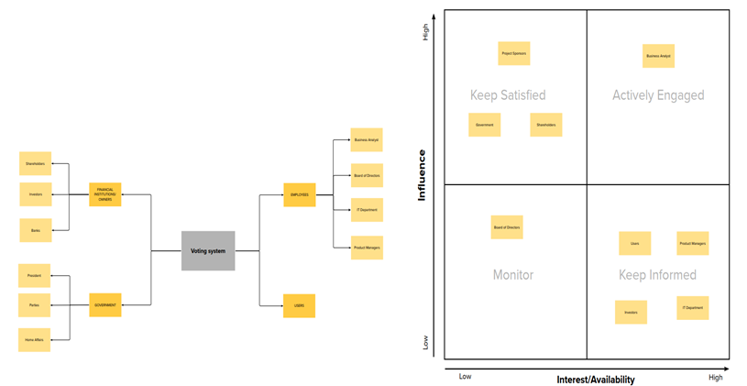
Stakeholders and maps

Slide 10
Software Requirements & Specification overview
Blockchain Network: The system should utilize a secure and decentralized blockchain network to record and store voting transactions securely.
The blockchain should support high throughput to handle many voting transactions during peak times. Can be limited between 25k-100k people.
Smart Contracts: Smart contracts should be used to define the rules and logic of the voting process, ensuring transparency and automation.
Smart contracts must be thoroughly tested and audited to prevent vulnerabilities and ensure accurate execution

Slide 11
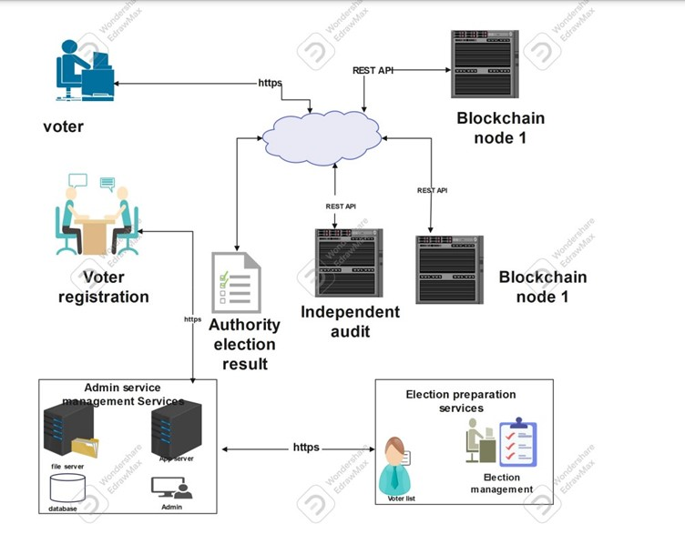




System Architecture
$12,000
$14,000
Property
Angel Investments
Revenue obtained from property rentals
Amount obtained through other investors
$32,000
Cash
Liquid cash we have on hand
$82,000
Shares
Number of shares converted into USD

Slide 12
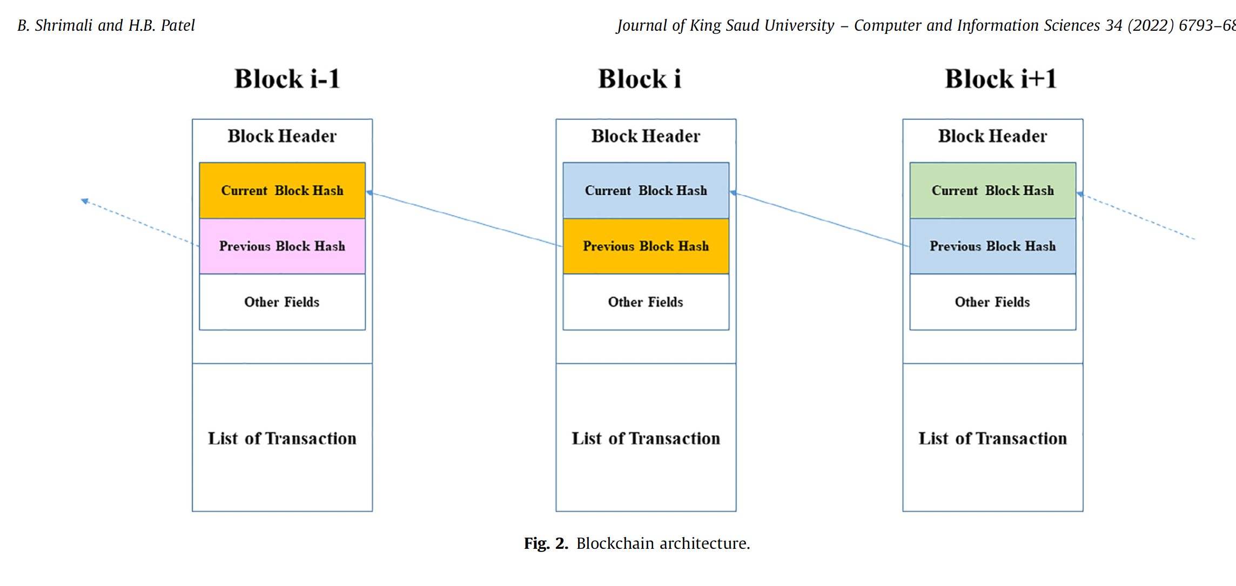
System Architecture
$12,000
$14,000
Property
Angel Investments
Revenue obtained from property rentals
Amount obtained through other investors
$32,000
Cash
Liquid cash we have on hand
$82,000
Shares
Number of shares converted into USD

Slide 13

Parties Onboarding
Training of IEC staff/Parties
User registration support
Communication and awareness

Slide 14
Current and future milestones
Connecting our App to IEC voters’ roll
Providing our API to the IEC Result department
Incorporate automatic Data Analyctics to Support the EIC result department

Slide 15
THANK YOU

